Slide 1
PHD Presentation By Gaurav Gupta

Slide 2

Slide 15

Slide 3

Slide 16

Slide 4
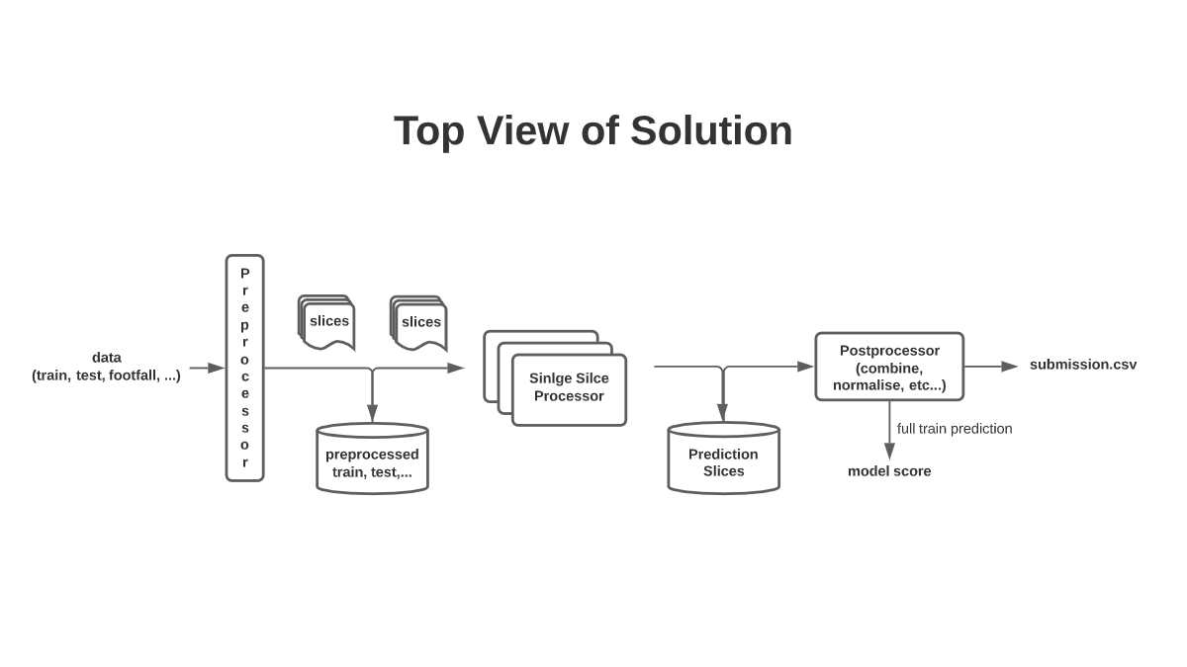
Slide 1

Slide 5
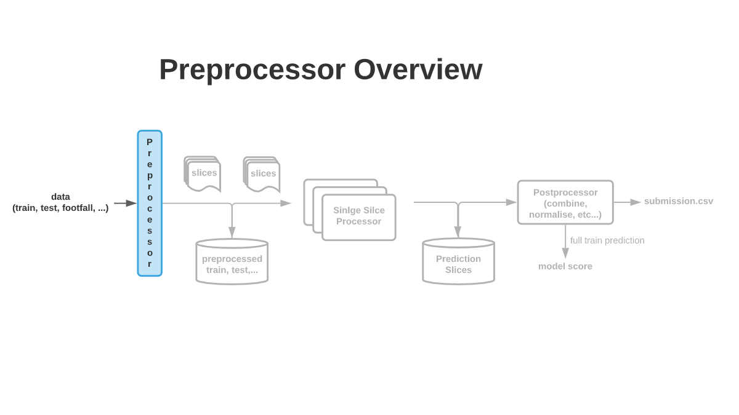
Slide 2

Slide 6
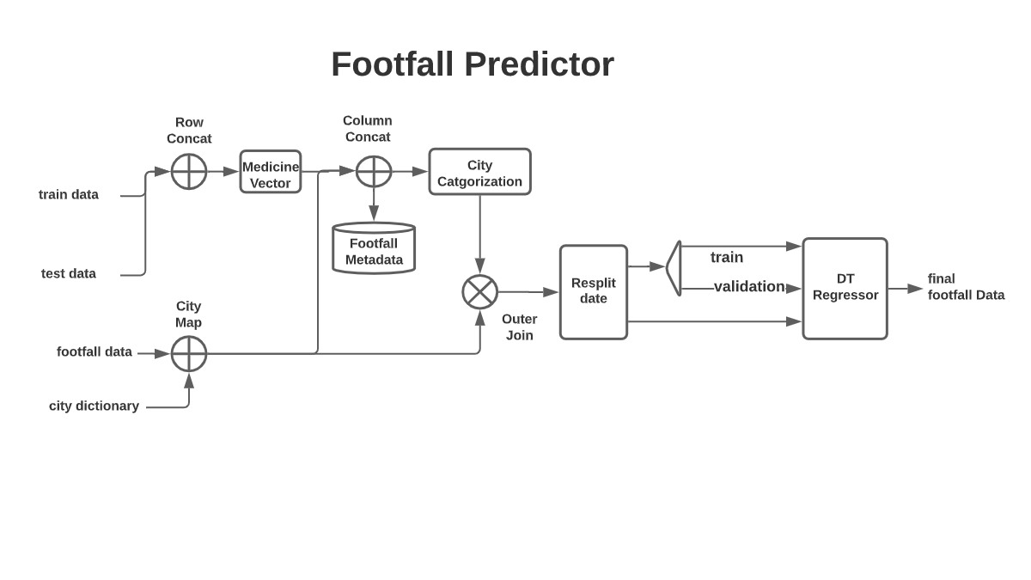
Slide 3

Slide 7
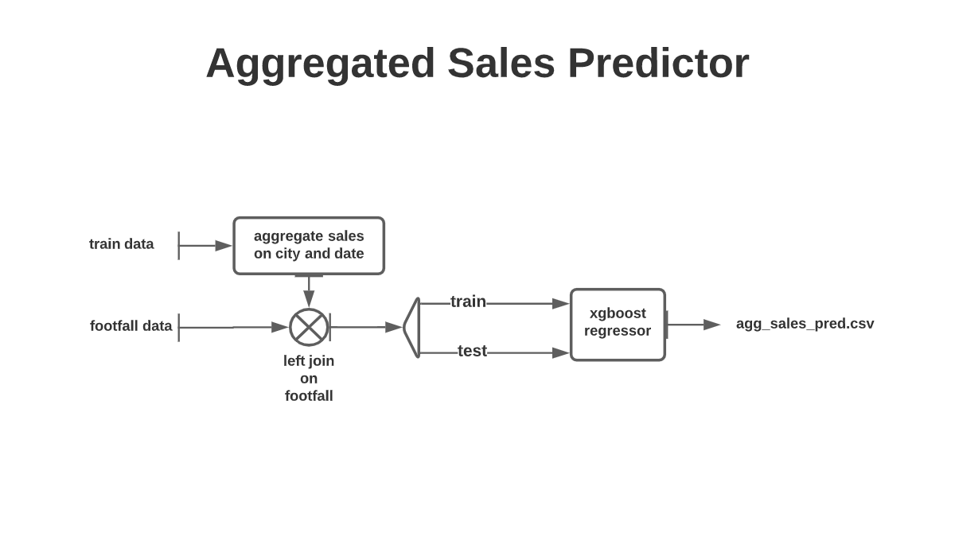
Slide 14

Slide 8
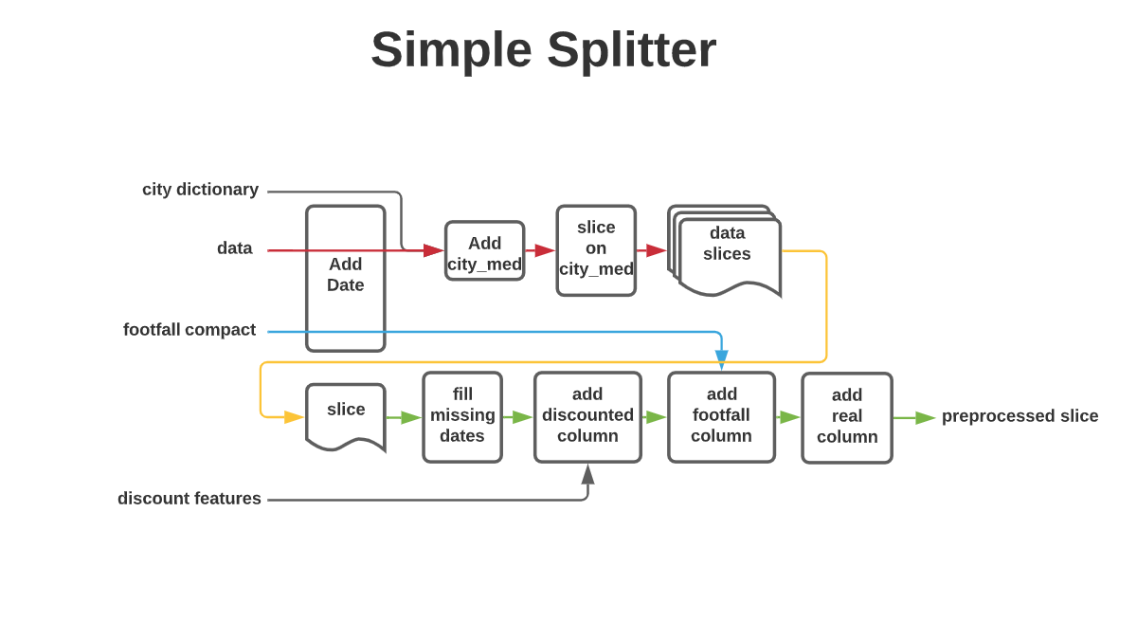
Slide 5

Slide 9
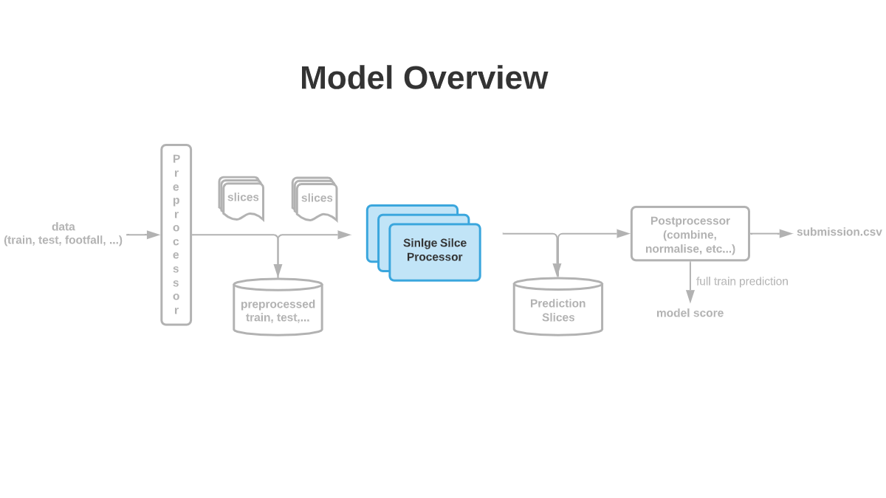
Slide 7

Slide 10
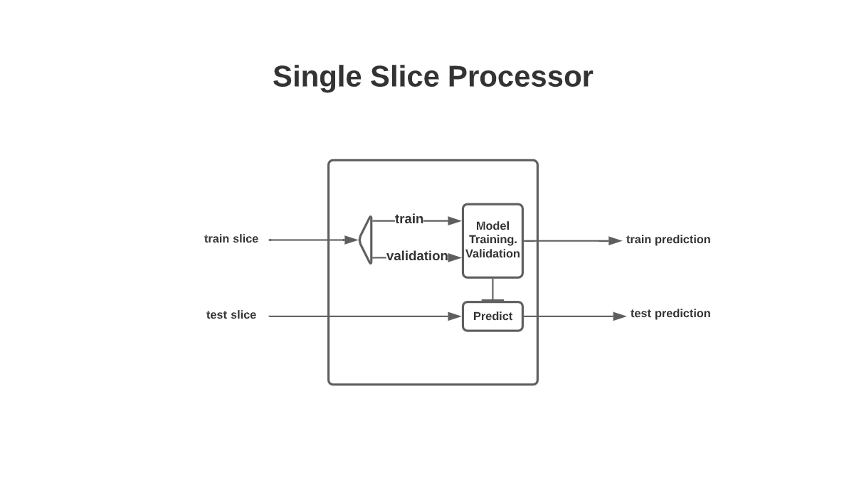
Slide 4

Slide 11
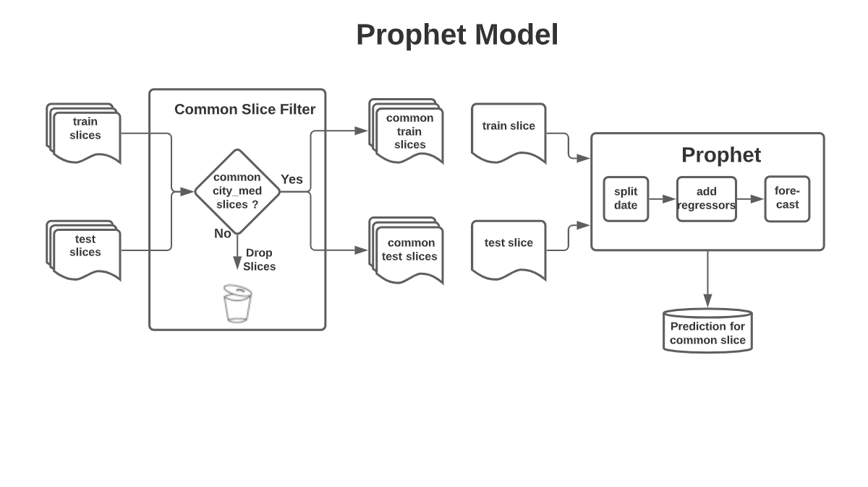
Slide 6

Slide 12
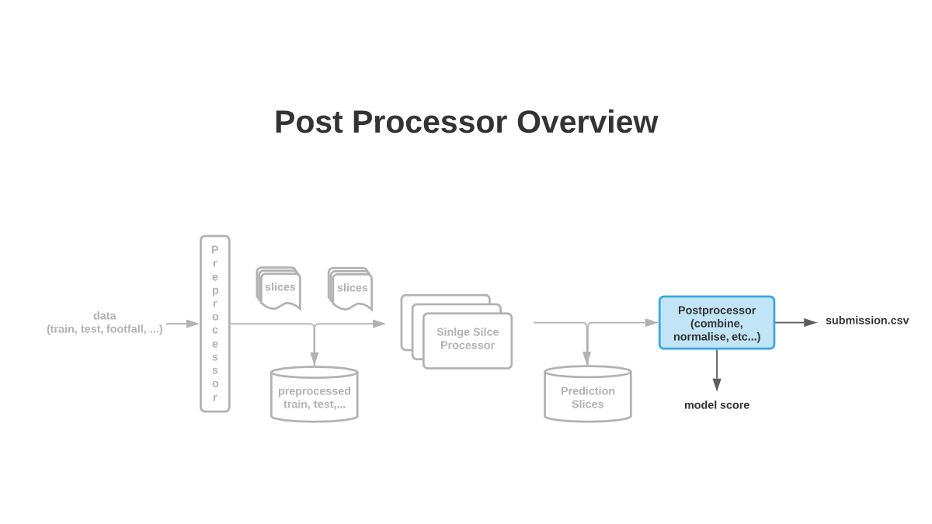
Slide 8

Slide 13
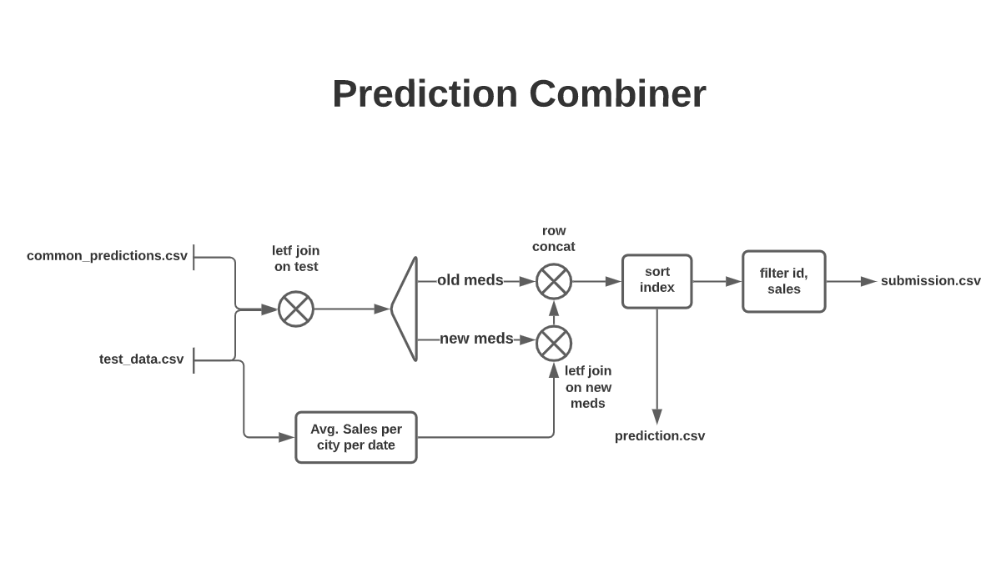
Slide 12

Slide 14
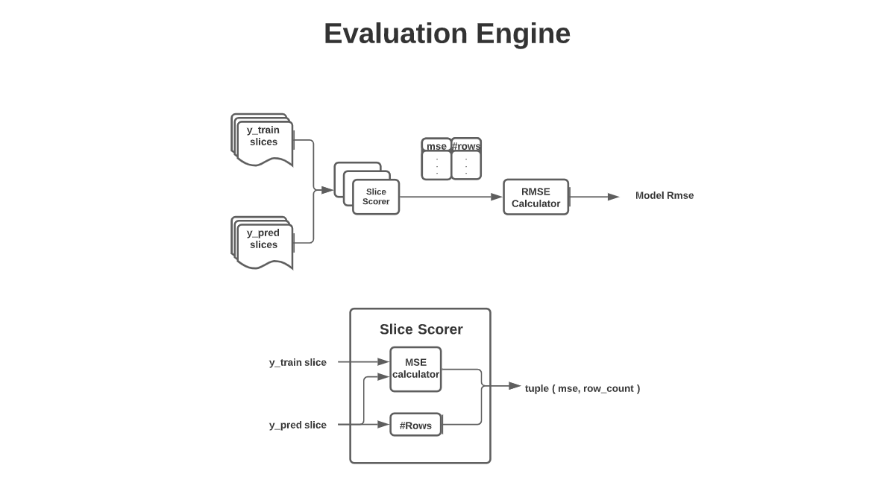
Slide 9

Slide 15
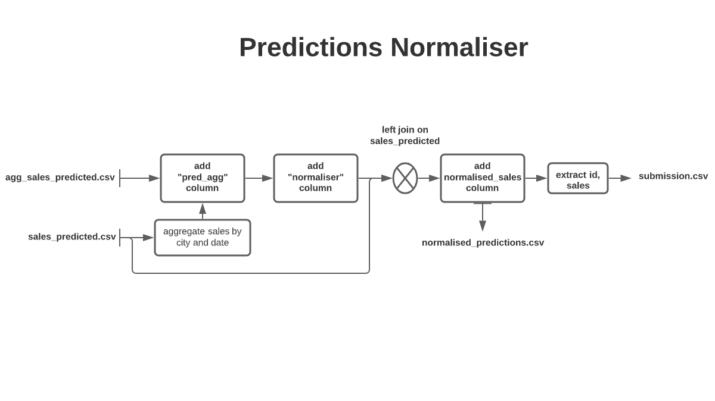
Slide 13

Slide 16
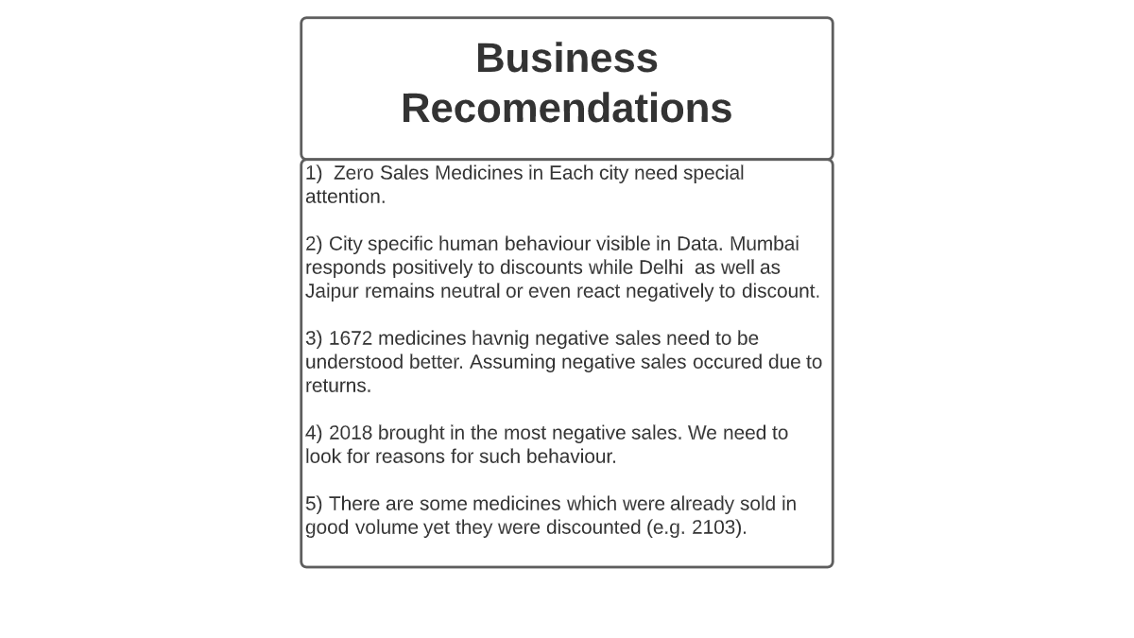
Slide 15

